Slide 1
Using Aggregation in Computation of Probabilities in Hierarchical Structures
Kurt Routley, B.Sc – Simon Fraser University
Oliver Schulte, Ph.D – Simon Fraser University

Slide 2
When to perform aggregation?
Method 1: Aggregate features, then learn probabilistic model
Method 2: Learn probabilistic model, then aggregate probabilities

Slide 3
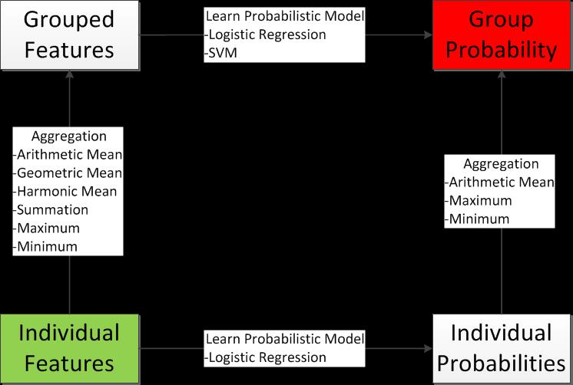

Slide 4
Method 1
Aggregate individual features to create grouped features.
Learn a probabilistic model of these grouped features.

Slide 5
Method 2

Slide 6
Training Set Description
MatchID | TeamID | PlayerID | Result | Games Played | Goals Scored | Assits | Hits | +/- | GiveAways | TakeAways | Time On Ice
1 | Canucks | H. Sedin | Win | 82
1 | Canucks | D. Sedin | Win | ...
... | one row for each Canucks skater in match 1 | ...
2 | Canucks | H. Sedin | Loss

Slide 7
Test Set with Probabilisic Predictions
Predicted Prob(Win) | MatchID | TeamID | PlayerID | Games Played | Goals Scored | Assits | Hits | +/- | GiveAways | TakeAways | Time On Ice
.61 | 3 | Canucks | H. Sedin | 82
.7 | 3 | Canucks | D. Sedin | ...
 | ... | one row for each Canucks skater in match 3 | ...
Notes:
geometric mean (arithmetic mean)

Slide 8
Test Set with SVM Scores
SVM Score | MatchID | TeamID | PlayerID | Games Played | Goals Scored | Assits | Hits | +/- | GiveAways | TakeAways | Time On Ice
0.8 | 3 | Canucks | H. Sedin | 82
-0.1 | 3 | Canucks | D. Sedin | ...
 | ... | one row for each Canucks skater in match 3 | ...
Notes:
try geometric mean, arithmetic mean.

Slide 9
Feature Aggregation
MatchID | TeamID | Result | Games Played | Goals Scored | Assits | Hits | +/- | GiveAways | TakeAways | Time On Ice
1 | Canucks | Win | 500 = sum over all players
2 | Canucks | Loss | 500

Slide 10
Training Set 2 Description
MatchID | TeamID | PlayerID | Result | Games Played | Goals Scored | Assits | Hits | +/- | GiveAways | TakeAways | Time On Ice | Goals in Game
1 | Canucks | H. Sedin | Win | 82 |  |  |  |  |  |  |  | 1
1 | Canucks | D. Sedin | Win | ... |  |  |  |  |  |  |  | 2
... | one row for each Canucks skater in match 1 | ...
2 | Canucks | H. Sedin | Loss

Slide 11
Feature Aggregation Test
Predicted Prob(Win) | MatchID | TeamID | Games Played | Goals Scored | Assits | Hits | +/- | GiveAways | TakeAways | Time On Ice
.6 | 3 | Canucks | 400 = sum over all players

Slide 12
Empirical Results for Method 2 using Only Last Season Statistics
Individual Results
Logistic Ridge | Number of Training Tuples | Number Correct | Training Accuracy | Number of Test Tuples | Number Correct | Test Accuracy | Overall Accuracy
1000 | 47,466 | 24,776 | 52.197% | 91360 | 47310 | 51.784% | 51.925%
Group Results
Logistic Ridge | Number of Team Matches | Number Avg Correct | Avg Percentage | Number Max Correct | Max Percentage | Number Min Correct | Min Percentage
1000 | 7714 | 4199 | 54.433% | 4199 | 54.433% | 3880 | 50.298%

Slide 13
Empirical Results for Method 2 using Last Season Statistics and Individual’s Game Statistics
Individual Results
Logistic Ridge | Number of Training Tuples | Number Correct | Training Accuracy | Number of Test Tuples | Number Correct | Test Accuracy | Overall Accuracy
Group Results
Logistic Ridge | Number of Team Matches | Number Avg Correct | Avg Percentage | Number Max Correct | Max Percentage | Number Min Correct | Min Percentage

Slide 14
Selection of Features

Slide 15
Conclusions

Slide 16
Questions?

Slide 17
Thank You
Kurt Routley, B.Sc – Simon Fraser University
kdr4@sfu.ca
Oliver Schulte, Ph.D – Simon Fraser University
oschulte@cs.sfu.ca

